Slide 1
Python Overview

Slide 2

Python Install
Install PyCharm Edu (also from JetBrains so very similar IDE setup)
Warning: there are two versions of Python: 2 (deprecated) and 3
USE 3! And the most recent STABLE version

Slide 3
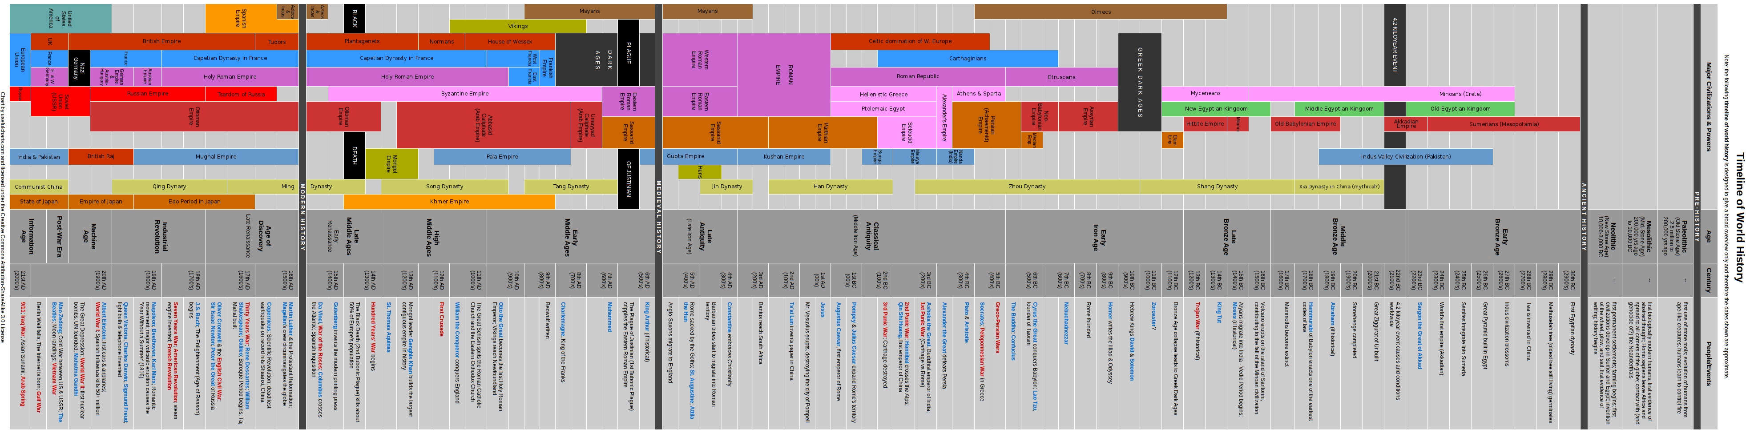
Python History
Python 1.0 (Guido van Rossum, ~1990)
Python 2.0 (2000) – “official” support finally ended 2020
Actual use, however….
Python 3.0 (2009) – more consistent syntax

Slide 4

Python Resources
Website: www.python.org
Online documentation and tutorials
Specifically, I suggest:
https://www.w3schools.com/python/
https://docs.python.org/3/tutorial/

Slide 5
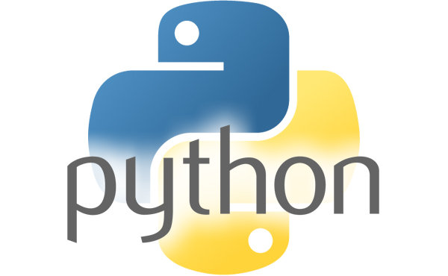
Python overview
Python is a “scripting” language
Also partially interpreted like Java
BUT has a run-eval-print loop (REPL)

Slide 6
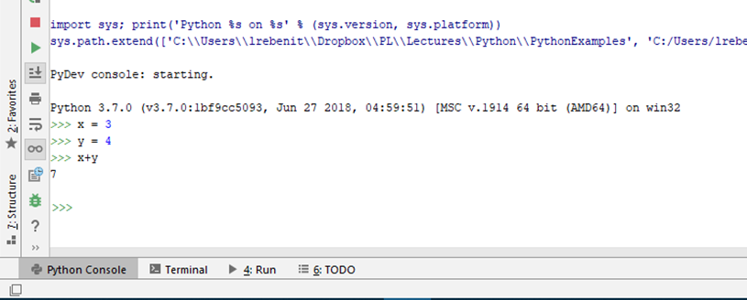
run-eval-print loop (REPL)
Partially compiles as it goes
Reuses the compiled stuff when possible
Slow the first run, but no wait for compilation
Faster the second time, due to partial compilation

Slide 7

Why Python?
Python is (now) a general-purpose programming language
Originally meant as a teaching language (this will show!)
Used in
Web
Statistics
And, the traditional…
SCRIPTING language purposes which shines in
Text manipulation
Gluing programs together
Prototyping

Slide 8
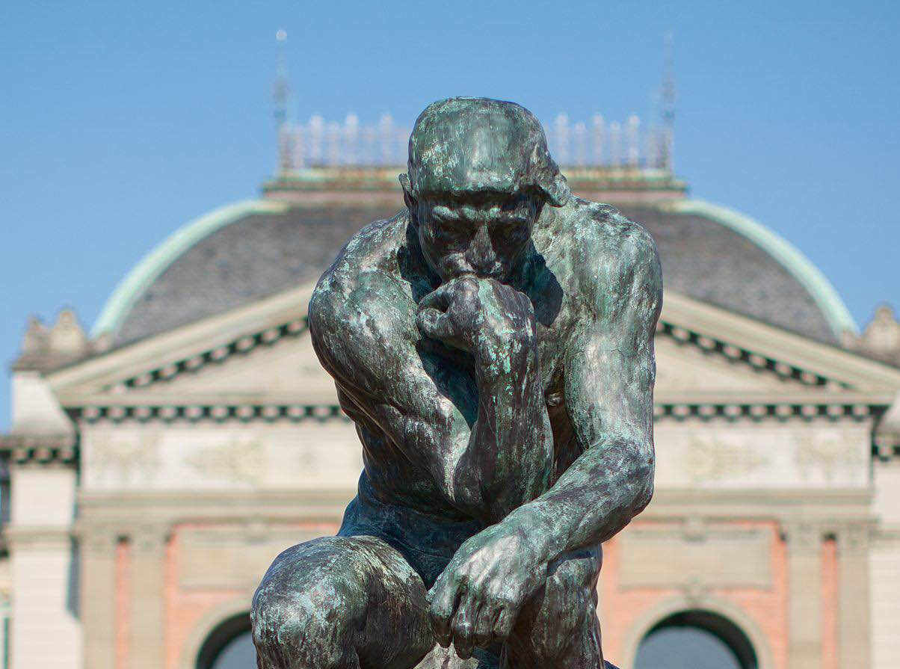
Python Philosophy
"Small and simple is beautiful" philosophy
Free, open source, cross platform
Highly extensible and modular
Multiparadigm PL, with support for procedural, object-oriented, and functional programming

Slide 9
Python Philosophy
Originally meant to encourages good programming practices
FORCES consistent indentation
In reality: python programs lend themselves to be EXTREMELY sloppy
Named after a well-known British comedy troop: Monty Python!

Slide 10

It’s “just a flesh wound” video
https://www.youtube.com/watch?v=-6VTci1Bunk

Slide 11

It’s “just a flesh wound” video
…(and it keeps going)…
Python is a bit similar, it does not crash easily
Which is what it is geared to (dynamic typing)
Great for odd input common to any user

Slide 12

Python Strengths
High level of abstraction
While optional, can be very much an OOP language
Expressive and powerful
Simple syntax, easy to learn and use
Consistent operators
Small, portable, cross platform, free
Support for many domains:
database, text processing, scientific and numeric apps, graphics, GUIs, web apps, etc.

Slide 13
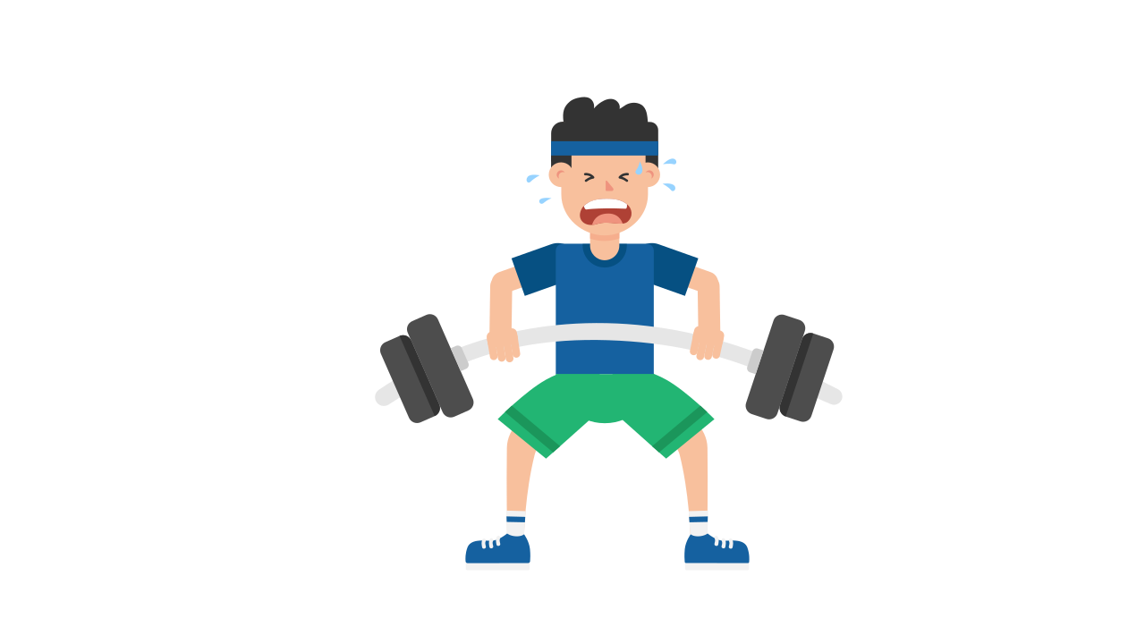
Python Weaknesses
Less efficient than C++:
Python is a higher-level language
Greater abstraction from the underlying hardware
Python is not fully compiled
However: high performance modules can be written in other languages (like C) as needed

Slide 14
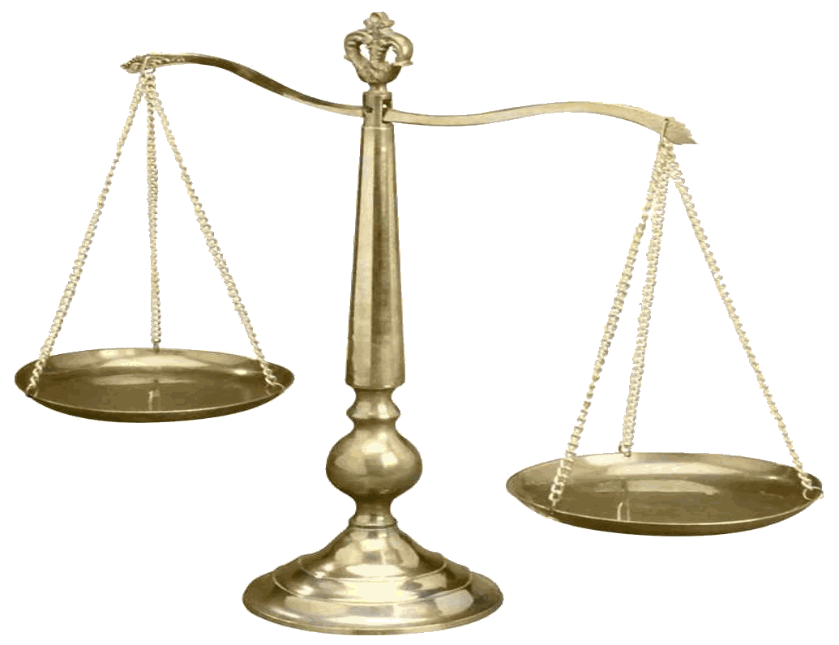
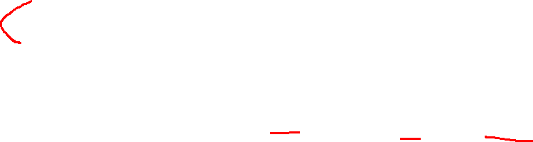
Python “it depends”
Dynamic typing:
Interpreter cannot automatically detect all type errors
However: dynamic typing makes it much easier to write general purpose routines
Moves type checks to the programmer
Garbage collection
The language handles clean dynamic memory allocations for you (Yay)
Tends to hit at the worst time (Boo)

Slide 15
Dynamic type binding
In C++
int x;
x is ALWAYS an int
In python
x = 1
An int
x = "text"
Now it is a string!

Slide 16
QUESTION
Given Python’s dynamic typing, is the following legal?
x = 2 z = "text" x = "more" a = x + z
Legal
Not legal

Slide 17

QUESTION
Given Python’s dynamic typing, is the following legal?
x = 2 z = "text" x = "more" a = x + z
Legal
Not legal

Slide 18
Switch to code

Slide 19
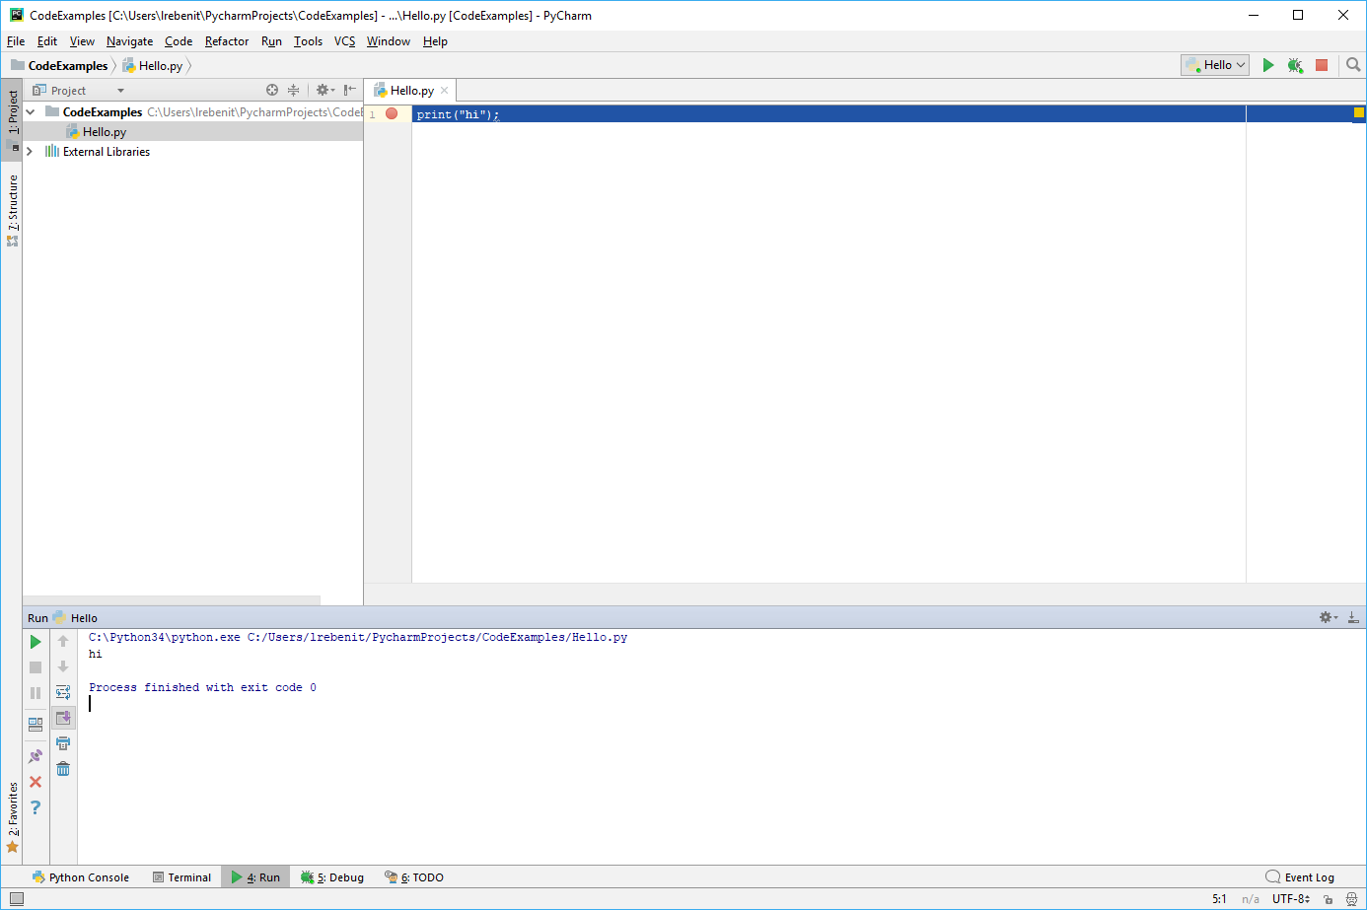
Show python as a script (Hello1.py)
>>>>Hello1.py
This is the content of the file
print( 'Hello, CSC461!' )
This breaks the read-eval-print loop
It does not output EVERY line anymore

Slide 20
Basic commenting
>>>>hello2.py
# is a single line comment
""" Multi line comment """
''' Also a multi line comment, but allows extras. More on this later '''

Slide 21
Python Program Execution
>>>>hello2.py
No main() function,
…but easy to fake it.
This pattern allows a program to be interpreted as either a script or a module:
if __name__ == '__main__': # "main" program statements go here
This is extremely useful when writing test for your code.

Slide 22
Modules
import_example.py
>>>>import_example.py
To add outside libraries
import module
Note, this usually means full path is need when using
OR, if you only want part
from module import class
Some important ones
import math
from random import gauss
from math import sqrt

Slide 23
Packages
Packages work similarly to java
Folder / maps to ‘.’
BUT, no extra line in file
When you think about it, why was it necessary in java to duplicate?

Slide 24
Packages
To add outside libraries
import folder.file
OR, if you only want part
from folder.file import classOrFunction
Pycharm adds a __init__.py file when you add a directory
This is run before any other file in the directory, and often can be deleted

Slide 25
Code Formatting
AGAIN, Indentation is required, not optional. Statement blocks (function bodies, if-else, loops) must be indented to the same level.
Legal
NOT Legal
if __name__ == '__main__': print("Hello") print("There")
if __name__ == '__main__': print("Hello") print("There")

Slide 26
Code Formatting
One statement per line recommended (in this class required).
Use backslash (\) to continue statement over multiple lines.
Use semicolon (;) to separate multiple statements on one line.
(BAD, don’t do this)
print("Hello" + \ "There")

